Slide 1


Increasing Bike Usage and Subscriptions

Slide 2
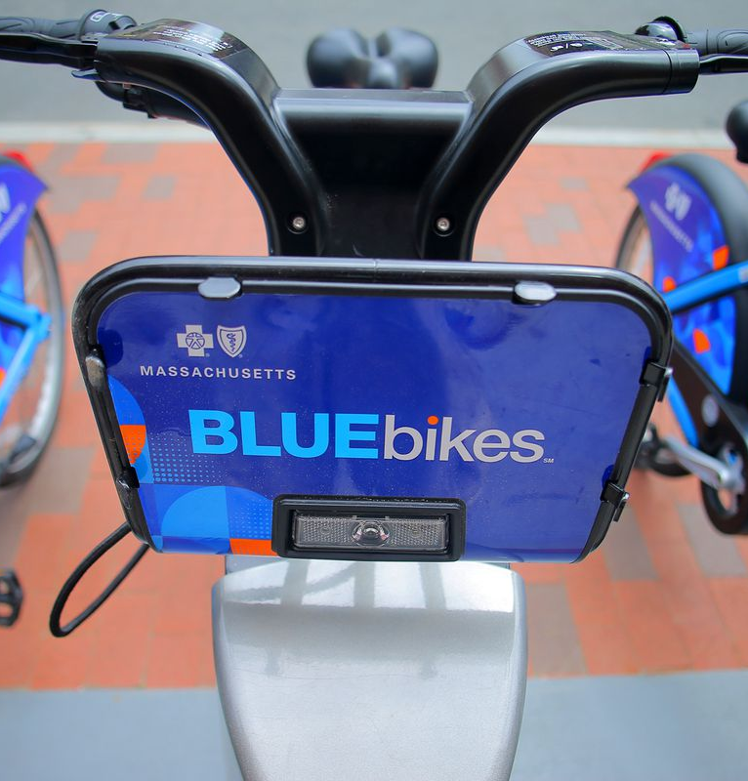

Presentation Agenda
A glimpse of what's coming up
Objective
Company overview
Descriptive data analysis
Goals
Findings
Recommendations
Conclusion

Slide 3
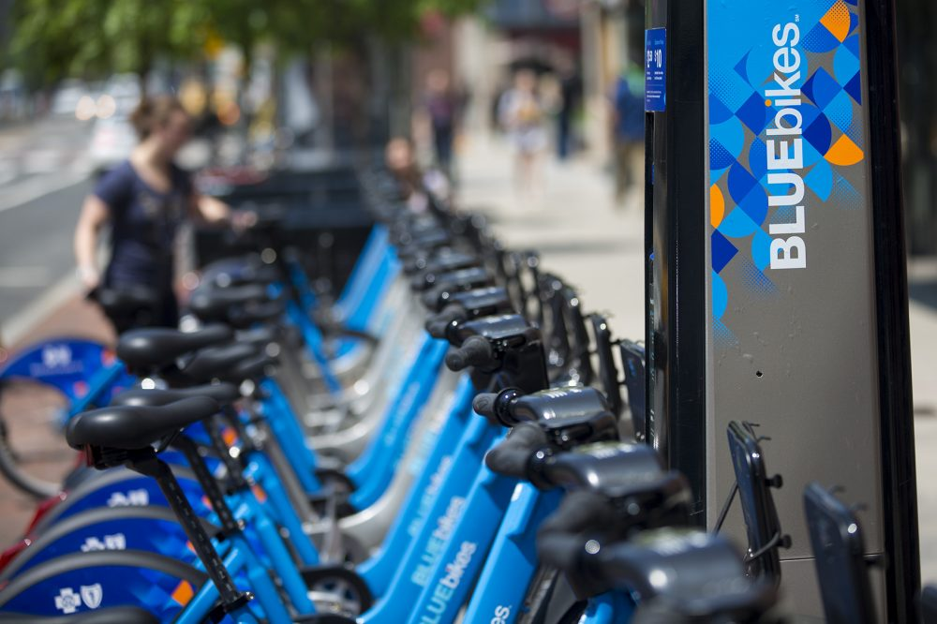
Objective of Analysis
The objective of our analysis is to help Lyft new management to increase bike usage and subscriptions

Slide 4

Company Overview
Founded
July 2011
Operates in:
Actual Fleet:
Bought by:
Boston
Cambridge
Brookline
Somerville
Everett
1,800 bikes
200 stations
Lyft, July 2019
610 Bikes
60 Stations
35 million trips
taken in 2017
Improve
Transportation
Sustainability
Improve Transportation
access
Improve
Transportation
Affordability

Slide 5
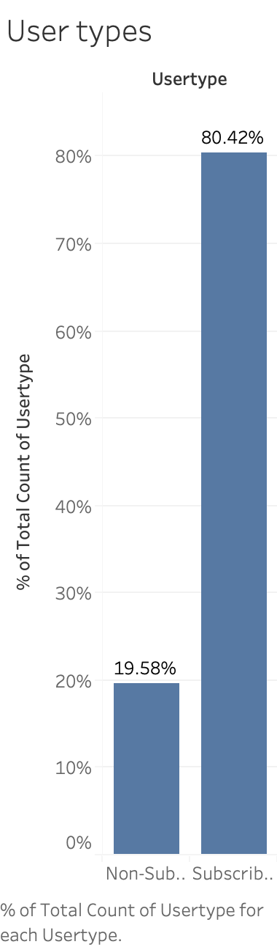
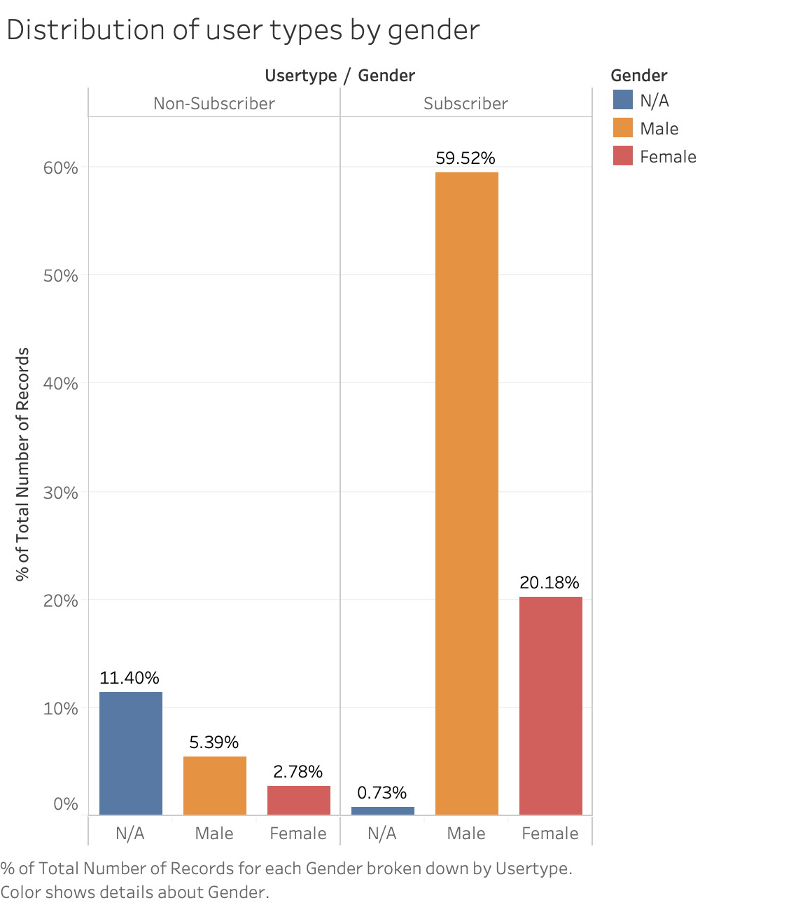
User types and gender distribution of user types
80% of their customers are subscribers
Males make up most of their customers by over 65%

Slide 6
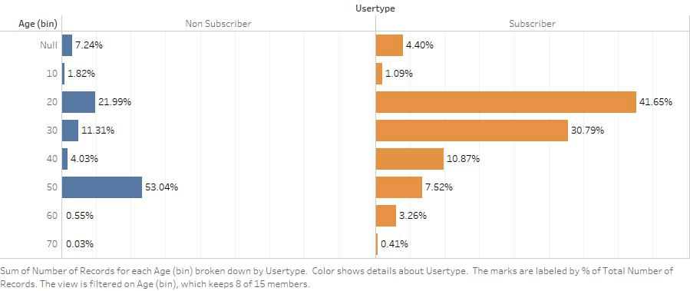
Trips based on age group & customer type
Age groups between 20 and 40 are the typical users of bike service.
The non-subscribers showing 53.04% for age group between 50-60 is due to the issue of missing values

Slide 7
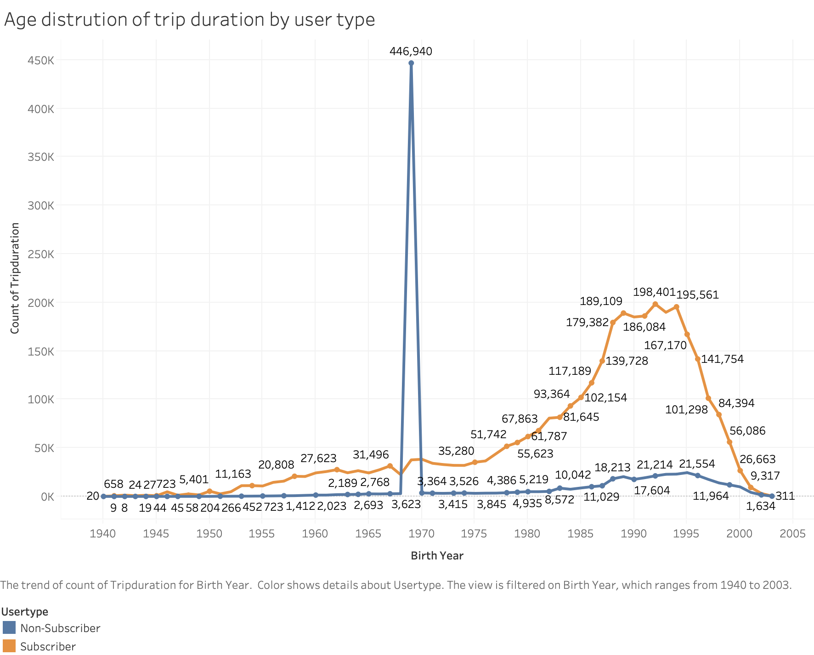
Trips based on Birth year & user type
The significant spike of customers born on 1969 is due to the missing values in sign up forms
Age distribution seems to be similar across customer types

Slide 8
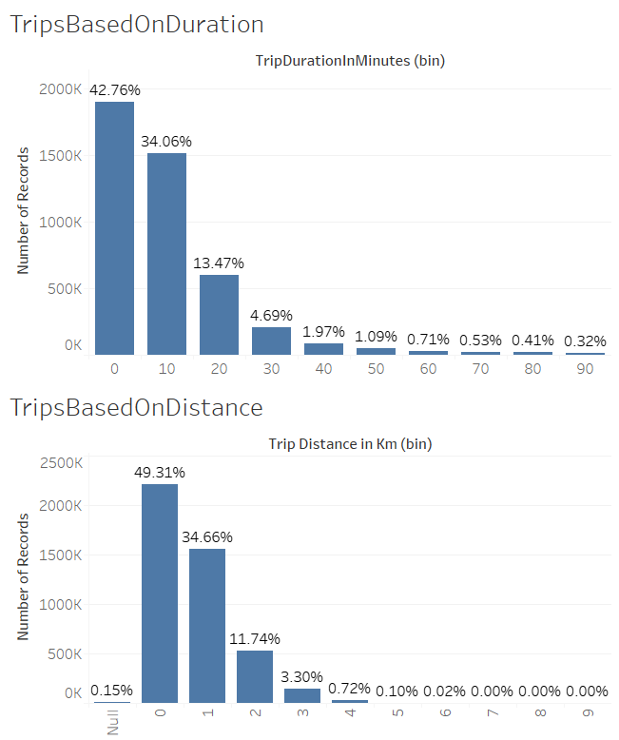
Trips based on duration
% of number of trips based on duration of the trip (in buckets of 10 min)
42.76% of the trips last 0-10 min which represents the major number of trips
Trips based on Distance
% of number of trips based on distance (in buckets of 1 km)
49.31% of trips last less then 1 km, followed by trips that are 1-2 km long, 34.66%

Slide 9
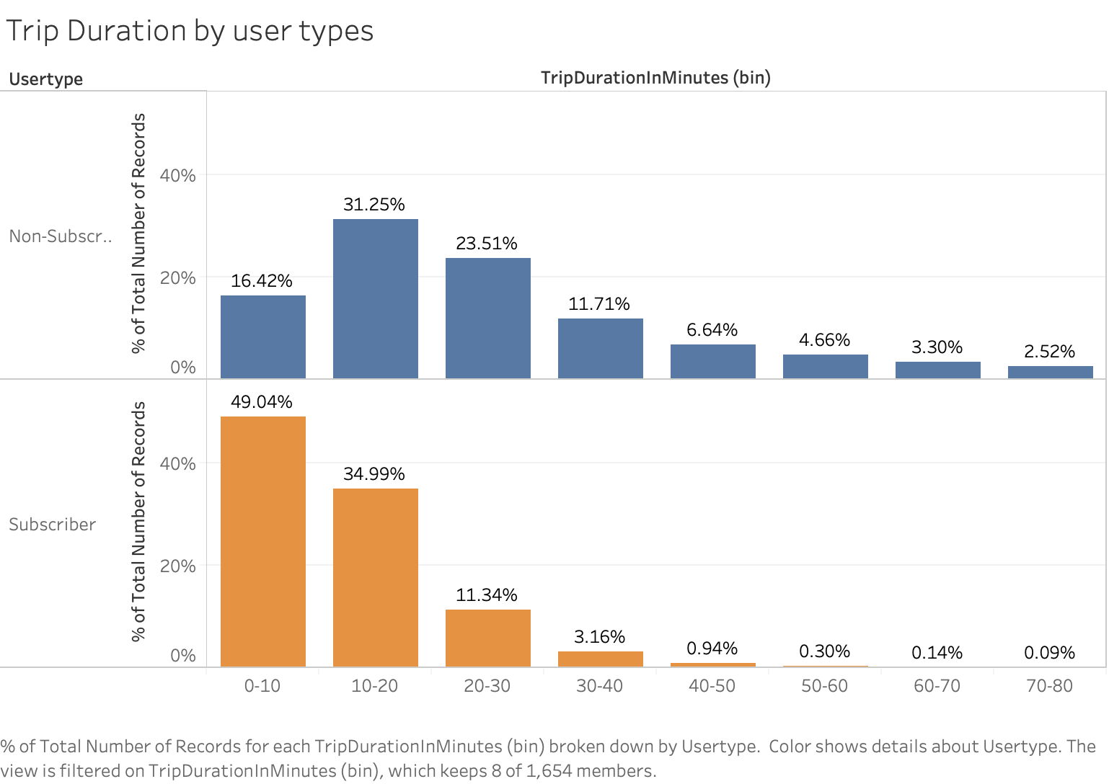
Trip durations by user types
Nonsubscribers use the bikes services for longer minutes than the subscribers

Slide 10
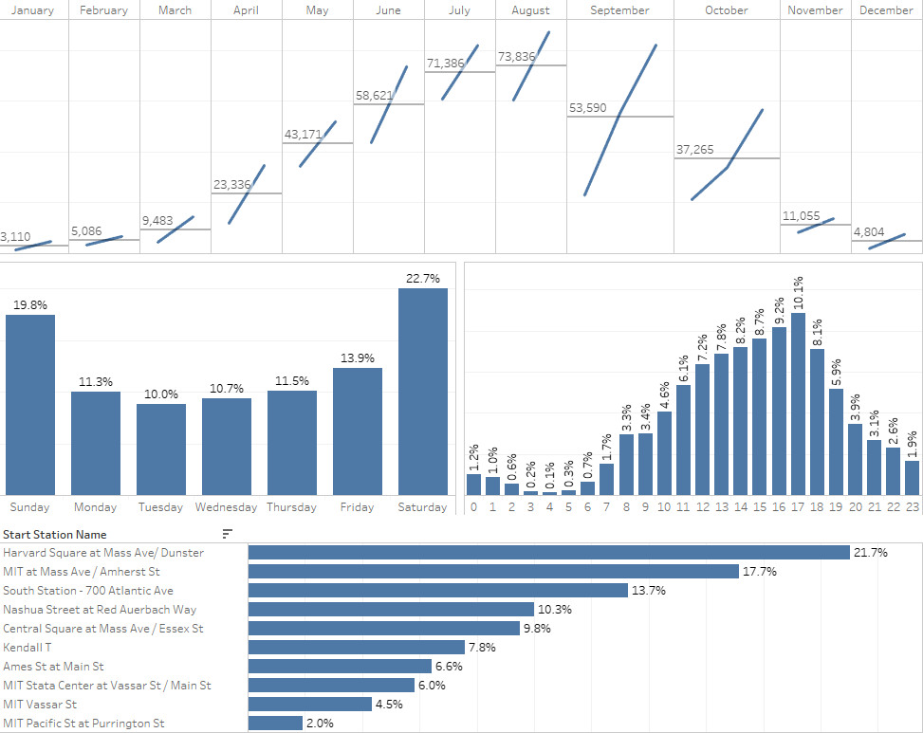
Nonsubscribers
Popular metrics for non-subscribers:
Seasonal view of number of trips based on months
% of trips based on days of the week
% of trips based on times in the day
Top 10 start stations based on number of trips

Slide 11
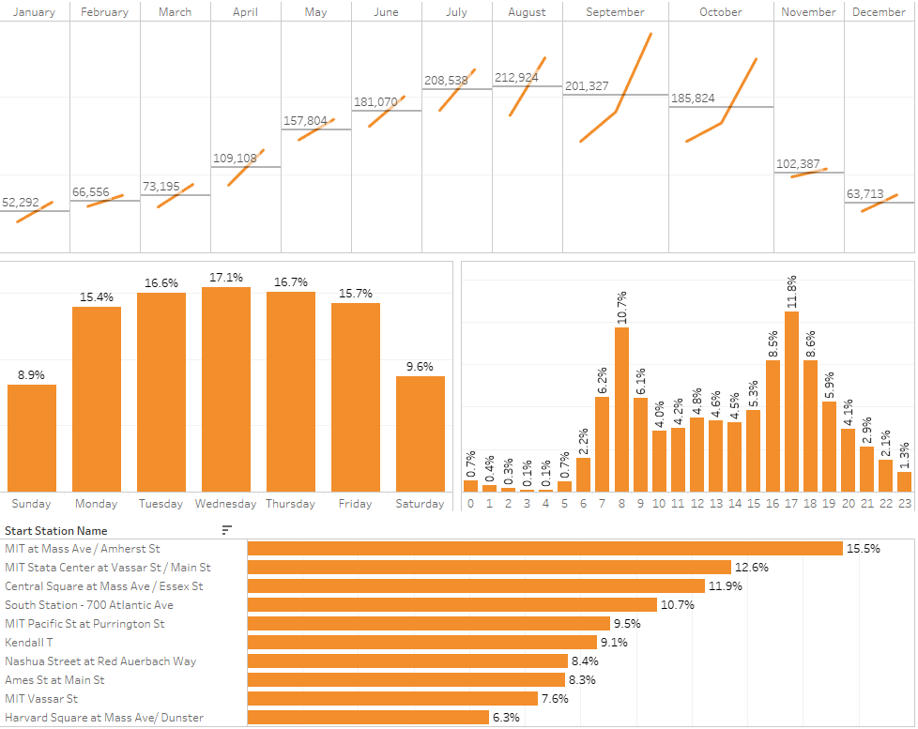
Subscribers
Popular metrics for subscribers:
Seasonal view of number of trips based on months
% of trips based on days of the week
% of trips based on times in the day
Top 10 start stations based on number of trips

Slide 12
Recommendations
Conclusions
Dock-less Bikes
Add safety measures and improve lane conditions
Improve promotion strategies
Gender and Age, mandatory fields in the sign-up form

Slide 13
Questions ?

